Slide 1
Fundamentals of CRE
Chemical Reaction Engineering
By
Dr Salah N. Farhan
Senior lecturer. Chem. Eng. Dept.
College of Engineering
University of Diyala
Salah N. Farhan College of Engineering Diyala University

Slide 2
Fundamentals of CRE
Chapter 1: Mole Balances
Learning Resources
Learning Resources
Salah N. Farhan College of Engineering Diyala University

Slide 3
General Algorithm for Solving Isothermal Reactor Problems
General Mole Balance Equation (GMBE)
Rate Laws
Write down rate law in terms of limiting reactant
Stoichiometry
relate concentration to volume and number of moles (for batch reactors) or to volumetric flow rate and molar flow rate (for flow reactor)
Relate volume or volumetric flow rate to conversion (X), pressure and temperature
Combine
Substitute rate law and stoichiometry in to the GMBE

Slide 4
General Algorithm for Solving Isothermal Reactor Problems

Slide 5
Class Problem-4
It is being considered that the following gas-phase reaction be carried out in a CSTR: A + 2B → 4C
The reactor will be operated isobarically and isothermally. The rate law for the reaction is given as: (-r_{A})=k ⋅ C_{A}⋅C_{B}
where, k = 8 L/mol-min at the operating temperature.
The total feed volumetric flow rate to the reactor at operating temperature and pressure is 10 L/min. The feed consists of A, B and an inert (I). The feed molar flow rates are F_{A0}= F_{B0}= 1 mol/s and F_{I0}=2 mol/s.
Calculate the volume of reactor required to achieve 80% conversion of the limiting reactant.
If all other conditions are kept constant (including total volumetric flow rate) but no inert is present in the feed, calculate the reactor volume required to achieve 80% conversion of limiting reactant

Slide 6
CSTR-in-series: Introduction to Damkohler Number

Slide 7
Damkohler Number (Da)
Da is a dimensionless number that can provide a quick estimate of the degree of conversion in continuous flow reactors.
First-order reaction
Second-order reaction
Da ≤ 0.1 usually results in conversion less than 10%
Da ≥ 10 usually results in conversion greater than 90%

Slide 8
CSTR in series
C_{AO}
X=0
v₀
C_{A1}
X=X₁
C_{A2}
X=X₂
V_{1 ;} k₁
V_{2 ;} k₂
Liquid-phase (v = v₀), first-order reaction
Mole Balance on CSTR-1
Mole Balance on CSTR-2

Slide 9
n-Equal Sized CSTR in series
C_{AO}
X=0
v₀
C_{An}
X=X_{n}
C_{A n-1}
X=X_{n-1}
V
V
V
V
V
All CSTR’s are operated at same temperature
[∴ k is same in all reactors]

Slide 10
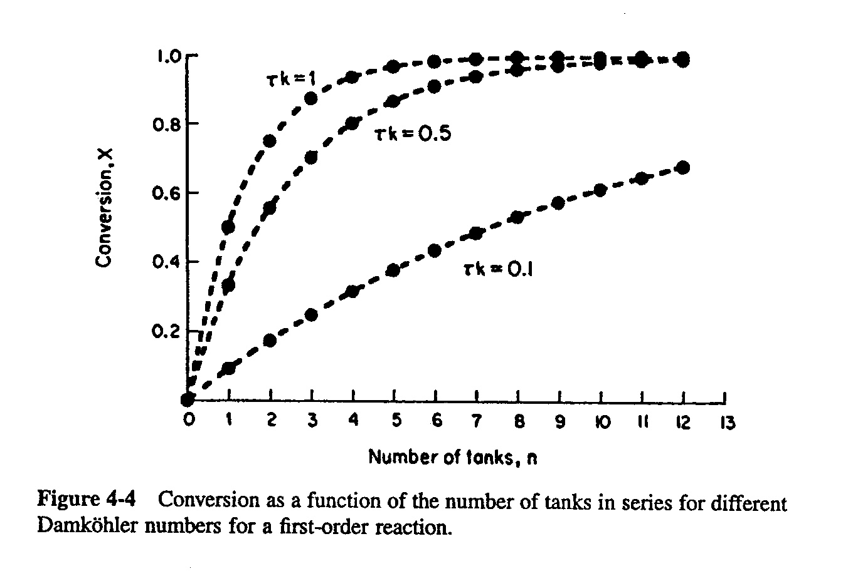
n-Equal Sized CSTR in series

Slide 11
n-Equal Sized CSTR in Parallel
v_{o}/n
C₁
X=X₁
V
v_{o}/n
C_{AO}
X=0
v₀
C_{A2}
X=X₂
V
v_{o}/n
C_{A3}
X=X₃
X = X_{mix}
V
What is the “conversion” of the mixed stream ?
v_{o}/n
C_{An}
X=X_{n}
V

Slide 12
‘n’ Equal-sized CSTRs - Which is a better configuration? Parallel or Series
If you had n-equal sized reactors available and had the option of setting them in series or parallel, which configuration would you choose to achieve maximum conversion for a first-order reaction occurring in liquid phase?
Justify your choice?

Slide 13
Revisiting Packed Bed Reactors

Slide 14
Solid Catalyzed Reactions
Reaction rates are usually expressed in terms of mass of catalyst loading.
in mol/time·mass of catalyst
The design equations can be derived in a manner similar to those for homogeneous reactors - by using mass (w) instead of volume (V).
Examples of solid catalyzed reactions:
Steam Methane Reforming (SMR) for HYDROGEN production
Conversion of NOx and CO in automobile catalytic converter
Styrene production

Slide 15
General Mole Balance for Packed Bed Reactors
F_{AO}
F_{A}
Input - Output + Gen = Accumulation
w
w+Δw
Mass of catalyst = Δw

Slide 16
Pressure Drop in Packed Bed Reactors
Flow of fluids through packed beds is accompanied by substantial pressure drop across the bed.
From reaction perspective, do we need to account for pressure drop in packed bed reactors ?
The answer depends on the type of reaction
For liquid-phase reactions, small changes in pressure does not affect concentration and consequently does not affect the reaction rates.
However, for gas-phase reactions, the concentrations are a function of pressure. Reduction in pressure implies reduction in concentration and, consequently, a reduction in reaction rates.

Slide 17
Relationship between concentration and pressure
(r_{i}) = k(T) × f(Concentration)
Case I: Liquid phase reactions
v = v_{O} =constant
Concentration does not depend on pressure. No need to calculate pressure to solve for conversion
Case II: Gas phase reactions
Inlet Conditions

Slide 18
Relationship between concentration and pressure
Case II: Gas phase reactions (cont.)
For isothermal reactor
(P/P_{O}) may vary along the reactor length
(r_{i}) = k(T) × f(Concentration)

Slide 19
Pressure Drop in an Isothermal PBR – Our Approach
Ultimately, we want to write two coupled differential equations that describes how the two variables - conversion (X) and pressure (P) - change with reactor length or mass of catalyst packed
Variation of conversion with catalyst weight
From GMBE
Variation of pressure with catalyst weight
Next, we will review equation describing pressure drop in packed beds

Slide 20
Pressure Drop in Packed Bed Reactors
ERGUN equation for pressure drop in a packed bed:
Laminar
(N_{RE} < 1)
Turbulent
(N_{RE} > 1000)
Differential equation
for pressure drop in bed of spherical packing

Slide 21
Pressure Drop in Packed Bed Reactors
In the above equation, some of the parameters are:
characteristic of the packing [porosity (φ), particle (D_{p})]
characteristic of fluid property [viscosity (μ), density (ρ)]
characteristic of operating parameters [mass velocity (G)]
Fixed for a given packed bed
Varies with operating condition and reaction mixture
The packing characteristics are usually considered to be invariant with respect to reactor length.
This leaves us with the following parameters to be evaluated as a function of reactor length
the fluid properties: viscosity (μ) and density (ρ)
the operating parameter G

Slide 22
Evaluating terms in Ergun equation
Superficial Mass velocity (G)
G is the mass flow rate per unit area (kg/m²-s).
Here, u and u₀ are velocities (in m/s)
NOT to be confused with volumetric flow rate (v)
For a reactor with a constant cross-section, G is constant.
Thus, if G is known at inlet it need not be evaluated at any other reactor position z

Slide 23
Evaluating terms in Ergun equation
Viscosity (μ)
Viscosity of gases are weak function of pressure. We can assume the gas mixture viscosity to be independent of pressure.
The viscosity of gases depend on the mixture composition. In a reactor, mixture composition will change, the gas mixture viscosity will also change.
Density (ρ)
Density of gases depend on pressure.
There are two ways of handling the pressure term:
in terms of inlet density, P/Po, T/To
in terms of local P, T and composition

Slide 24
Pressure Drop in PBR – Simplified functional form
If numerical method is applied to solve for differential equation, a simpler and more elegant approach is to calculate density at any given position (z) in the reactor using ideal gas law and local conditions:
Average Molecular Weight
of gas mixture
where,

Slide 25
Pressure Drop in an Isothermal PBR
Our GOAL is to write two coupled differential equations that describes how the two variables - conversion (X) and pressure (P) - change with reactor length or mass of catalyst packed
Variation of conversion with catalyst weight
From GMBE
Variation of pressure with catalyst weight

Slide 26
Fundamentals of CRE
Salah N. Farhan College of Engineering Diyala University

Slide 27
Fundamentals of CRE
Salah N. Farhan College of Engineering Diyala University

Slide 28
Fundamentals of CRE
Salah N. Farhan College of Engineering Diyala University

Slide 29
Fundamentals of CRE
Salah N. Farhan College of Engineering Diyala University

Slide 30
Fundamentals of CRE
Salah N. Farhan College of Engineering Diyala University

Slide 31
Fundamentals of CRE
Salah N. Farhan College of Engineering Diyala University

Slide 32
Fundamentals of CRE
Salah N. Farhan College of Engineering Diyala University

Slide 33
Fundamentals of CRE
Salah N. Farhan College of Engineering Diyala University

Slide 34
Fundamentals of CRE
Salah N. Farhan College of Engineering Diyala University

Slide 35
Fundamentals of CRE
Salah N. Farhan College of Engineering Diyala University

Slide 36
Fundamentals of CRE
Salah N. Farhan College of Engineering Diyala University

